Slide 1
Introducing CodeBot
Python with Robots Mission 2
Lesson 1 Objectives 1-5

Slide 2

Pre-Mission Warm-Up
In your Mission 2 Lesson 1 log, answer the first pre-mission warm-up question:
What are some things you can connect to a computer or laptop?

Slide 3
Pre-Mission Warm-Up
In your Mission 2 Lesson 1 log, answer the second pre-mission warm-up question:
Why do you think you should learn how to program a computer?

Slide 4
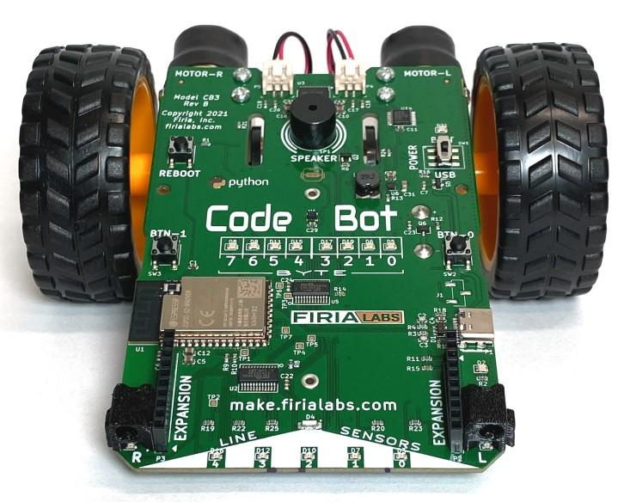
Mission 2: Introducing CodeBot
CodeBot is a computer on wheels!
It has lots of sensors and controls.
You will be writing Python code to bring this hardware to life!
DO THIS:
Write the definition of CodeBot in your mission log.

Slide 5
Mission 2: Introducing CodeBot
There are quite a lot of hardware peripherals on CodeBot.
Some are used for output.
This means they receive instructions from CodeBot and do something with them.
Some are used for input.
This means they give instructions or information to CodeBot.

Slide 6
Mission 2: Introducing CodeBot
Some input peripherals on CodeBot:
Line sensors
Proximity sensors
Motion / orientation sensor (accelerometer)
Wheel rotation sensors (encoders)
Buttons

Slide 7
Mission 2: Introducing CodeBot
Some output peripherals on CodeBot:
LEDs (small one-colored lights)
Speaker
Motors
DO THIS:
Write the output and input peripherals in the correct column in your mission log.

Slide 8
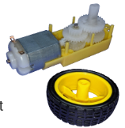
Objective #1: Motors
CodeBot motors power the wheels that move it around.
You’ll soon be controlling those motors with Python code!

Slide 9
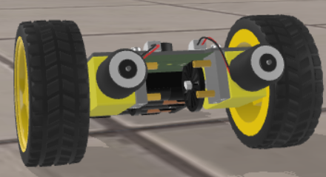
Objective #1 Activity
DO THIS:
Close the Objective Panel.
Use the camera controls to rotate the CodeBot.
Click on one of the motors.

Slide 10
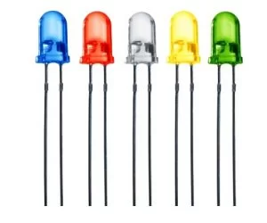
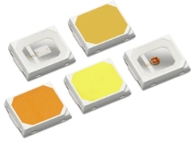
Objective #2: LEDs - Lighting the Way
Light emitting diodes are tiny electronic devices that produce light.
They usually light up only one color, like red or green.
They won’t do anything until you write some code to control them!

Slide 11

Objective #2: LEDs - Lighting the Way
Up close the LEDs look like little clear boxes.
CodeBot has 17 LEDs. Can you find them all?

Slide 12
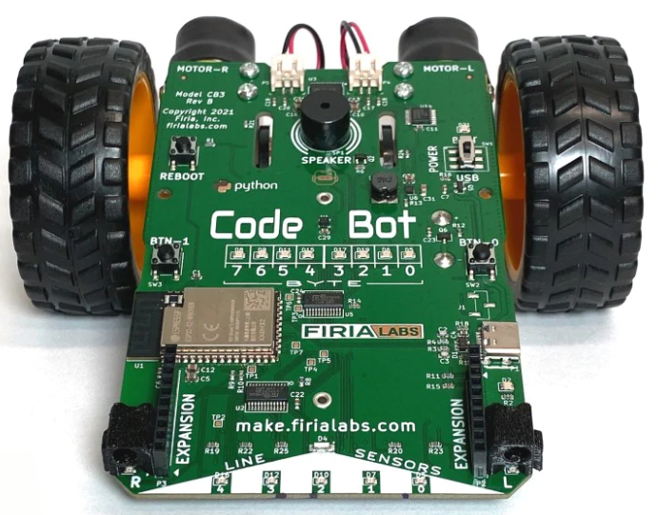
Objective #2 Activity
DO THIS:
Close the Objective Panel.
Use the camera controls to zoom in.
Look for LEDs.
Click on at least one LED.

Slide 13
Objective #2 Activity
DO THIS:
Go to your mission log.
Answer the two questions for Objective 2.

Slide 14
Objective #3: Speaker
CodeBot has a speaker.
It is a real speaker, not just a buzzer!
DO THIS:
Close the Objective Panel.
Use the camera controls to zoom in.
Click on the speaker.

Slide 15
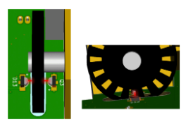
Objective #4: Wheel Encoders
Your code can control the power applied to the motors.
To know how far the wheels turn, you need to sense their rotation.
Wheel encoders are discs with slots. When they rotate, a light beam passes through the slots.
Your code can count the pulses of light to see how far the wheel has rotated.

Slide 16
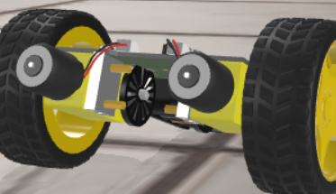
Objective #4 Activity
DO THIS:
Close the Objective Panel.
Use the camera controls to rotate the CodeBot to the back.
Click on a wheel encoder.

Slide 17
Objective #5: Pushbuttons
Some inputs for CodeBot are:
Pushbuttons
Line Sensors
Proximity Sensors
Accelerometer
And more…

Slide 18
Objective #5 Activity
DO THIS:
Close the Objective Panel.
Use the camera controls to zoom in.
Locate all three buttons.
Click on one of the buttons.
Answer the question on your mission log for Objective 5.

Slide 19
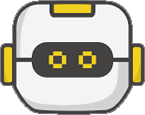
Mission quiz
You have learned a lot about CodeBot. Now …. time for a quiz!
Read about static electricity.
Answer the two questions on your mission log for the Quiz.
Answer the quiz question in CodeSpace.
CODEX
QUIZ

Slide 20
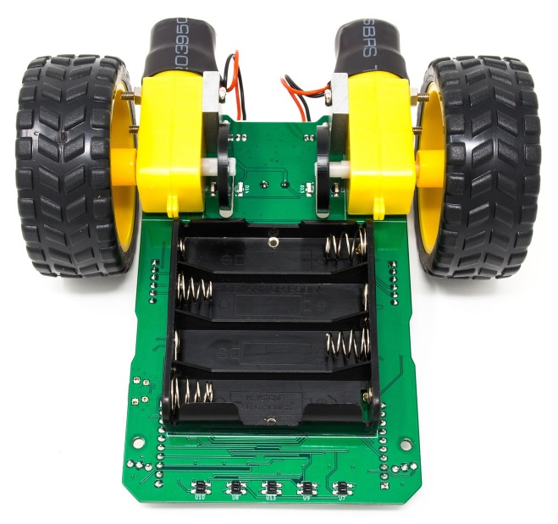
More CodeBot Peripherals
You can now identify several peripherals on CodeBot. Let’s get familiar with a few more.
Line Sensors
You can see the line sensor LEDs, but what about the line sensors? They are on the back side of the circuit board, on the other side of the LEDs.
Proximity Sensors
CodeBot has two proximity sensors. They look like eyes on the left and right of CodeBot.

Slide 21
CodeSpace Review
Accelerometer
The accelerometer is small but mighty. It can detect motion and orientation.
USB Connector
The USB connector allows CodeBot to communicate with a computer. It can also receive power through the USB cable.
Power Switch
The power switch allows CodeBot to go autonomous with batteries instead of power through a USB connection.

Slide 22
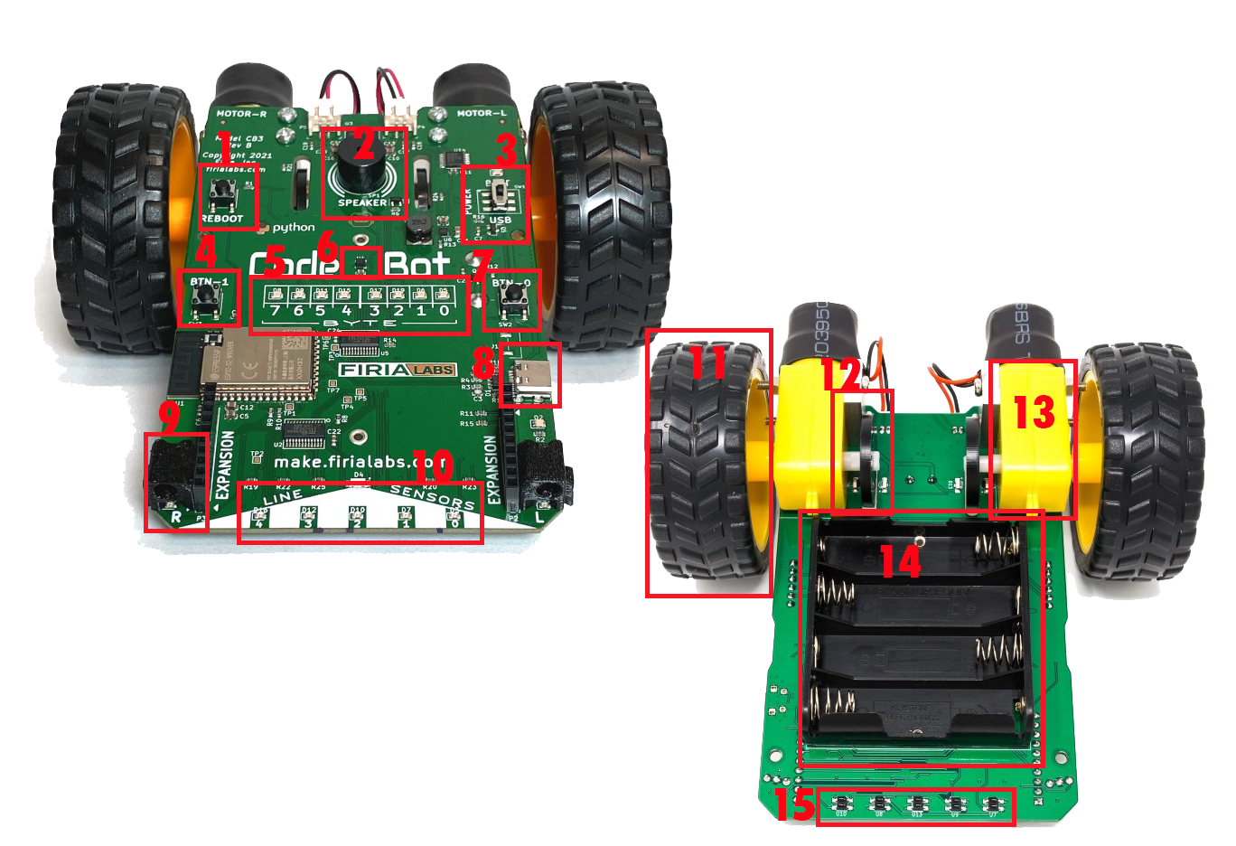
CodeBot Review
Your turn for a review.
Go to your mission log and label the parts of CodeBot.

Slide 23
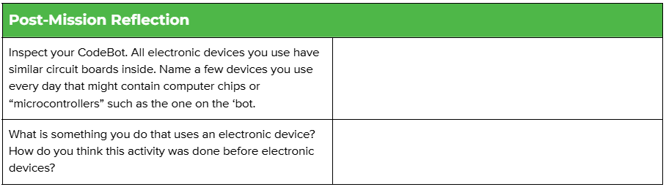
Post-Mission Reflection
Complete the post-mission reflection in your Mission 2 Lesson 1 Log

